Slide 1

DEPARTMENT OF COMPUTER SCIENCE & ENGINEERING
SCHOOL OF COMPUTING
1156CS701- MAJOR PROJECT
WINTER SEMESTER 2022-2023
INTERNSHIP THROUGH DIND
BOSTON SOLUTIONS PVT LTD
SEMESTER END PROJECT VIVA VOCE EXAMINATIONS
“Generate Profile Picture Using Neural Arts”
SUPERVISED BY
Dr. R. Anto Pravin, M.E.
PRESENTED BY
1. K. Sai Kiran (15062)(19UECS0448)
2. K. Soma Sekhar (13228)(19UECS0445)
3. A. Hari Krishna (13300)(19UECS0029)

Slide 2
INDUSTRY DETAILS
Industry Name/Institute Name : Boston Solutions Pvt.Ltd.
Duration of Internship (From Date – To Date) : 9 Jan – July 6
Duration of Internship in Months : 3 months
Industry Guide Name : Sajan S

Slide 3
AGENDA
ABSTRACT
OBJECTIVE
INTRODUCTION
LITERATURE REVIEW (SOFT COPY OF PAPERS TO BE LINKED AS HYPERLINK)
DESIGN AND METHODOLOGIES
STANDARDS & POLICIES USED
IMPLEMENTATION
TESTING
INPUT AND OUTPUT
INCLUDE DEMO VIDEO (You Tube URL of complete demonstration of project )
CONCLUSION
FUTURE ENHANCEMENTS
WEB REFERENCES LINK
REFERENCES
PLAGIARISM REPORT OF PPT
INCLUDE YOUR 2 PHOTOS OF YOUR INDUSTRY WORKING ENVIRONMENT
INTERNSHIP CERTIFICATE (Offer Letter and Completion certificate)
POSTER PRESENTATION
JOURNAL/CONFERENCE PUBLICATION PROOF(MANDATORY TO ATTACH)

Slide 4
ABSTRACT
Generate Profile Picture Using Neural Arts is a process that involves creating unique and personalized digital portraits.
This technique involves feeding input data into a neural network, which then generates a series of images based on the learned patterns and features from the training dataset.
The generated images can be edited, modified, and enhanced to create a profile picture that represents an individual's unique characteristics and style.
The process of creating personalized digital portraits using Neural Arts provides a novel way for individuals to express themselves visually in the digital world.
This abstract explores the technique of generating profile pictures using Neural Arts and highlights its potential applications in various fields.
The resulting image is an original, aesthetically pleasing creation that can be used as a profile picture on social media or other online platforms.

Slide 5
OBJECTIVES
Aim of the Project:
This project aims to provide an innovative and efficient way for individuals to create original and aesthetically pleasing profile pictures for use on various online platforms, such as social media sites.
Scope of the Project:
The system will be trained on a large dataset of images and styles and will allow users to input their preferences to generate a profile picture that reflects their unique style and personality.

Slide 6
INTRODUCTION
Generating profile pictures using neural arts is an innovative and exciting way to create unique and personalized images.
This approach involves using artificial intelligence, specifically neural networks, to analyze and interpret an image, and then apply a creative style to it.
With this technology, users can transform their own photographs or images into entirely new works of art, in a wide range of styles, from classic to modern, realistic to abstract.
By leveraging the power of neural arts, anyone can create a visually stunning and engaging profile picture that truly reflects their personality and style.
Whether you are an artist, a social media influencer, or just someone looking to create a memorable online presence, generating profile pictures using neural arts is a fun and easy way to express your creativity and make a lasting impression.
By harnessing the power of deep neural networks, this project can provide valuable insights into how artificial intelligence can be used to enhance human creativity and expression.

Slide 7
LITERATURE REVIEW
Yongcheng Jing; Yezhou ’YZ’ Yang; Zunlei Feng; Jingwen Ye; “Neural Style Transfer: A Review”, Journal of Engineering Research and Sciences (JENRS), 20 January 2022.
Neural style transfer has gained significant attention in recent years due to its ability to generate visually appealing images. The authors introduced a new normalization technique called Adaptive Instance Normalization (AdaIN), which improves the quality of stylized images by aligning the mean and variance of the content and style features. The authors showed that their method can produce highly stylized images with improved quality compared to previous methods. Several contributions have been made to improve the quality and efficiency of NST methods, including the introduction of real-time style transfer and the use of novel normalization techniques. With the ongoing research in this field, NST is expected to continue to evolve and produce more impressive results.

Slide 8
LITERATURE REVIEW
Flavio Luiz; Romulo Augusto Vieira Costa; “Neural Networks and Digital Arts: Some Reflections”, IEEE Transactions on Visualization and Computer Graphics 26(11):3365-3385,January 2022.
The authors begin by discussing the history of digital art and its evolution over time, highlighting the ways in which technology has played a significant role in shaping its development. They then move on to introduce the concept of neural networks and explain how they differ from traditional algorithms. Neural networks, they argue, have the ability to ”learn” and adapt to new information, making them particularly well-suited to creative tasks such as generating novel imagery or music.The paper goes on to explore several case studies of neural network-generated art, including the work of artist Anna Ridler. Ridler’s pieces, which use neural networks to generate images based on data sets, serve as a demonstration of the potential of this technology to create new and innovative forms of artistic expression.

Slide 9
LITERATURE REVIEW
Young- Jin Heo; Byung-Gyu Kim; Partha Pratim Roy; “Frontal Face Generation Algorithm from Multi-view Images Based on Generative Adversarial Network”, Journal of Multimedia Information System VOL. 8, NO. 2, June 2021 (pp. 85-92).
The use of Generative Adversarial Network (GAN) for frontal face generation from multi-view images has shown promising results. Several studies have demonstrated the effectiveness of this approach in generating realistic and high-quality frontal faces. The GAN architecture allows for the generation of diverse and unique face images, which is particularly useful in applications such as facial recognition, virtual reality, and entertainment. However, there is still room for improvement in terms of the quality and diversity of generated faces, as well as the ability to handle occlusions and variations in facial expressions. Further research is needed to address these challenges and to explore the potential of GANs in generating realistic and diverse frontal face images from multi-view inputs.

Slide 10
LITERATURE REVIEW
Berfin Korukcu; Selen cicek; Mustafa Koc; “URBAN MAP GENERATION IN ARTIST’S STYLE USING GENERATIVE ADVERSARIAL NETWORKS (GAN)”, Conference: ASCAAD 2022: The 10th International Conference of the Arab Society for Computation in Architecture, Art and Design, October 2022.
The use of Generative Adversarial Networks (GANs) in generating urban maps in an artist’s style has shown promising results. The literature review highlights several approaches to generating urban maps using GANs, including image-to-image translation, conditional GANs, and deep convolutional GANs. These techniques have been shown to produce visually appealing and realistic urban maps that resemble the styles of various artists. However, there are still some challenges to be addressed, such as the lack of diversity in the generated maps and the need for larger datasets to improve the quality of the generated images. Nonetheless, GANs hold great potential for generating urban maps that are both aesthetically pleasing and functional for urban planning and design purposes.

Slide 11
LITERATURE REVIEW
Ander Iriondo; Vignesh Sampath; Inaki Maurtua; J. J. Aguilar;“Intraclass Image Augmentation for Defect Detection Using Generative Adversarial Neural Networks”, EU H2020 ITN DIGIMAN4.0 Digital Manufacturing Technologies for Zero-defect Industry 4.0 Production, February 2023.
The use of intraclass image augmentation through generative adversarial neural networks (GANs) has shown great potential in improving the accuracy of defect detection in industrial settings. The technique allows for the creation of a larger and more diverse dataset, which in turn improves the generalization of the model. Studies have shown that this approach can significantly improve the detection of various types of defects, including cracks, scratches, and dents. Additionally, intraclass image augmentation using GANs is a computationally efficient method that can be implemented in real-time for automated defect detection in industrial environments. Overall, the findings suggest that this technique holds promise for improving the accuracy and efficiency of industrial defect detection systems.

Slide 12
DESIGN AND METHODOLOGIES
Image processing
Testing and Debugging
Neural Style Transfer

Slide 13
MODULE:1
Image processing: For image operations, this module imports necessary libraries like os, sys, scipy, matplotlib, and PIL. Additionally, it prepares the VGG-19 model for transfer learning, which will be utilized to extract the input images’ features. The code then defines a function called compute content cost that takes the difference between the feature maps of the content image and the generated image to determine the content cost of the generated image. The module also includes a function called gram matrix that uses the correlation between the various channels of the feature maps to figure out the style cost of the generated image.
Testing and Debugging: Test and debugging code for the functions defined in the module 4.4.1 can be found in this module. It consists of a series of tests that are carried out to verify that the functions are performing as expected. The functions are validated and their output is compared to expected values using random input data in the tests. Error handling is also part of the module to make sure that any errors are caught and shown to the user in a way that is easy to understand.

Slide 14
Neural Style Transfer: The code to carry out the neural style transfer operation can be found in this module. It resizes the style and content images to the standard size of 400 x 400 pixels after reading them in. The VGG-19 model is used to extract the feature maps of the content and style images, and the module uses the functions defined in the first module to calculate the costs of each image’s content and style. The module then establishes the optimizer to be used to reduce overall cost and initializes the generated image as a noisy image. The optimization process is carried out by the module for a predetermined number of iterations, and at each iteration, the cost of the generated image is calculated and the image is updated accordingly. The generated image produced by the neural style transfer operation is finally sent out by the module.

Slide 15
STANDARDS & POLICIES
Respect privacy and consent: Make sure that you have the consent of the person whose image you are using to create the neural art. Additionally, ensure that the neural art you generate does not reveal any sensitive information about the person.
Avoid bias: Neural art algorithms can be biased based on the data they are trained on. Ensure that the training data is diverse and representative of the population to avoid perpetuating biases.
Respect intellectual property: Ensure that you have the necessary permissions and licenses to use any images or artwork that are incorporated into the neural art.
Disclosure: Clearly disclose that the profile picture was generated using neural art and not a real photograph.
Avoid deception: Do not use neural art to deceive others by misrepresenting yourself or creating false personas.

Slide 16
IMPLEMENTATION
Architecture Diagram
Data –Flow Diagram
Use Case Diagram
Collaboration Diagram(If applicable)
E-R Diagram

Slide 17
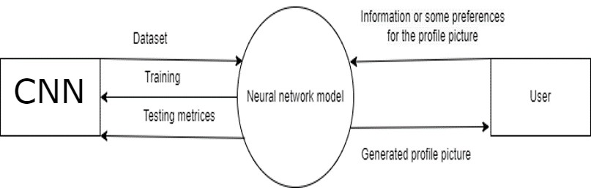
ARCHITECTURE DIAGRAM

Slide 18
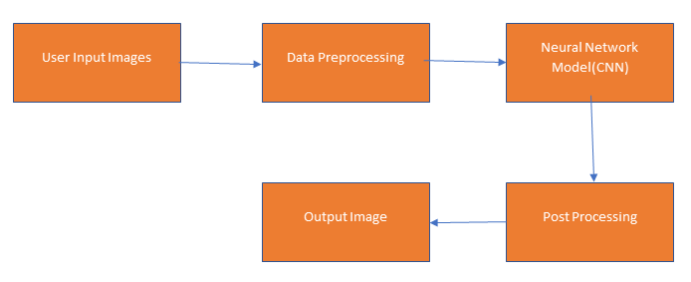
DATA FLOW DIAGRAM

Slide 19
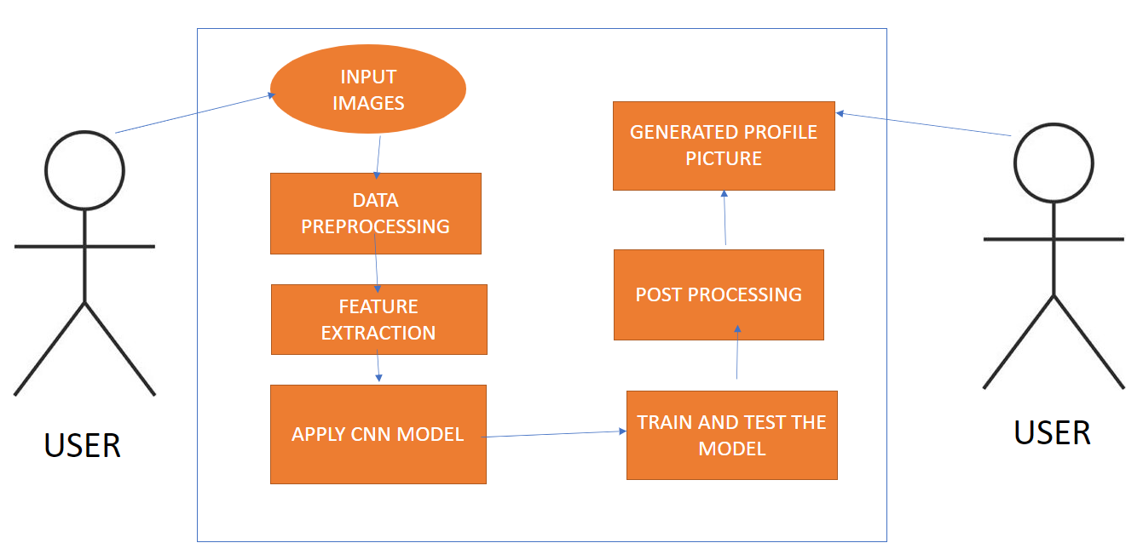
USE CASE DIAGRAM

Slide 20
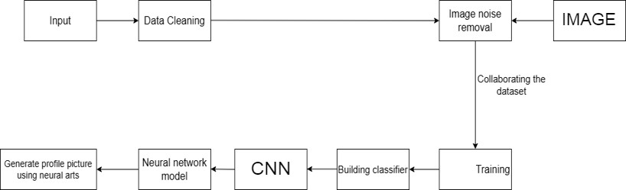
COLLABRATION DIAGRAM

Slide 21
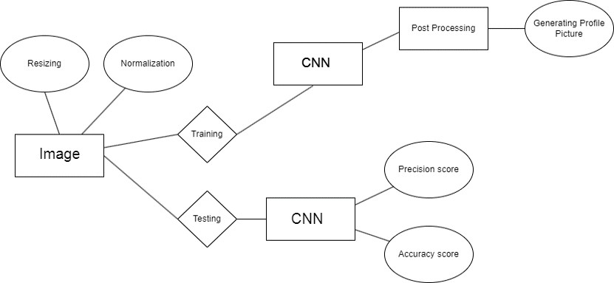
ER DIAGRAM

Slide 22
TESTING
UNIT TESTING
INTEGRATION TESTING
FUNCTIONAL TESTING
WHITE BOX TESTING
BLACK BOX TESTING

Slide 23
UNIT TESTING
The input data (image) should be preprocessed in a way that it can be fed into the neural network for generating a profile picture. This involves resizing, cropping, and normalization of the input image. The unit test should ensure that the input data is being preprocessed correctly.
The performance of the model should be tested to ensure that it is efficient and fast. This can be done by testing the time taken by the model to generate a profile picture.

Slide 24
INTEGRATION TESTING
The first step in integration testing is to identify the different components of the system. In this case, the components may include the neural arts algorithm, the image database, the user interface, and the system's backend.
After identifying the components, create test cases that cover different scenarios and interactions between the components. For example, you can create test cases that test how the algorithm performs with different types of images, how the system handles user inputs, and how the user interface displays the generated profile pictures.

Slide 25
FUNCTIONAL TESTING
Functional testing is a type of software testing that evaluates the functionality of an application by testing its features against the specifications outlined in its requirements.
This involves testing the user interface of the application to ensure that it is easy to use and meets user expectations. For example, testers can check that users can easily upload images to the application and apply various neural art styles to the image.

Slide 26
WHITE BOX TESTING
White box testing for generating profile pictures using neural arts involves testing the internal logic and code of the software to ensure that it is working correctly.
Check the software's performance in terms of speed and resource usage. Test the software with different types of inputs to ensure that it can handle large volumes of data efficiently.

Slide 27
BLACK BOX TESTING
Black box testing is a software testing technique that focuses on testing the functionality of a system without having knowledge of its internal workings.
In the case of generating profile pictures using neural arts, black box testing can be used to verify that the system is generating profile pictures that meet the desired specifications.

Slide 28
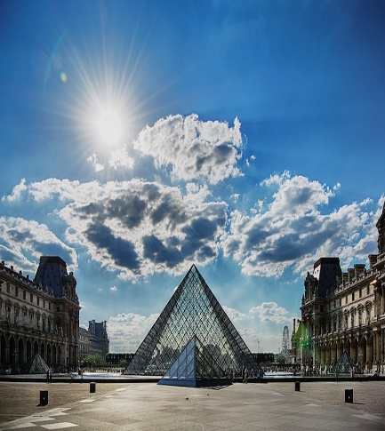
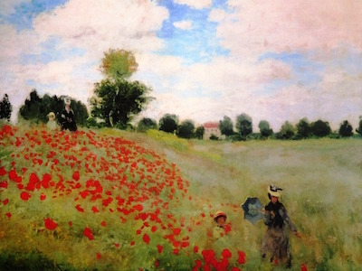
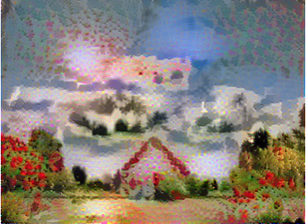
INPUT AND OUTPUT

Slide 29
DEMO VIDEO
https://youtu.be/ADtxo5Om-rg

Slide 30
CONCLUSION
In conclusion, "Generate Profile Picture Using Neural Arts" is an innovative and exciting project that combines the power of machine learning algorithms with deep neural network models to create personalized profile pictures for users. By leveraging large datasets of images and styles, this project can generate unique and personalized profile pictures for users based on their input preferences.
The project has a wide range of applications, including online dating, social media, and professional networking platforms, where users need to present themselves with an image that best represents them. By providing personalized profile pictures, the system can help users create a positive and impactful first impression on potential connections.

Slide 31
Future Enhancements
In the future, there are several enhancements that can be made to the ”Generate Profile Picture Using Neural Arts” system. One possible improvement is to incorporate more advanced neural networks and machine learning algorithms that can produce more realistic and visually appealing images. Another enhancement could involve incorporating user input and preferences into the image generation process, allowing users to provide specific details about the desired image style, color palette, and other visual features. Finally, the system could be optimized for faster and more efficient processing, potentially allowing it to generate images in real-time, which could be useful for applications such as video conferencing or social media platforms.

Slide 32
Web references
DeepArt.io - https://deepart.io/
NeuralStyler - http://neuralstyler.com/
NeuralStyle.art - https://neuralstyle.art/
AI Portraits - https://www.aiportraits.com/
Neural Network Art - https://www.neuralnetworkart.com/

Slide 33
REFERENCES(as per IEEE format only)
Yongcheng Jing; Yezhou ’YZ’ Yang; Zunlei Feng; Jingwen Ye; “Neural Style Transfer: A Review”, Journal of Engineering Research and Sciences (JENRS), 20 January 2022.
Flavio Luiz; Romulo Augusto Vieira Costa; “Neural Networks and Digital Arts: Some Reflections”, IEEE Transactions on Visualization and Computer Graphics 26(11):3365-3385,January 2022.
Young- Jin Heo; Byung-Gyu Kim; Partha Pratim Roy; “Frontal Face Generation Algorithm from Multi-view Images Based on Generative Adversarial Network”, Journal of Multimedia Information System VOL. 8, NO. 2, June 2021 (pp. 85-92).
Berfin Korukcu; Selen cicek; Mustafa Koc; “URBAN MAP GENERATION IN ARTIST’S STYLE USING GENERATIVE ADVERSARIAL NETWORKS (GAN)”, Conference: ASCAAD 2022: The 10th International Conference of the Arab Society for Computation in Architecture, Art and Design, October 2022.
Ander Iriondo; Vignesh Sampath; Inaki Maurtua; J. J. Aguilar;“Intraclass Image Augmentation for Defect Detection Using Generative Adversarial Neural Networks”, EU H2020 ITN DIGIMAN4.0 Digital Manufacturing Technologies for Zero-defect Industry 4.0 Production, February 2023.

Slide 34
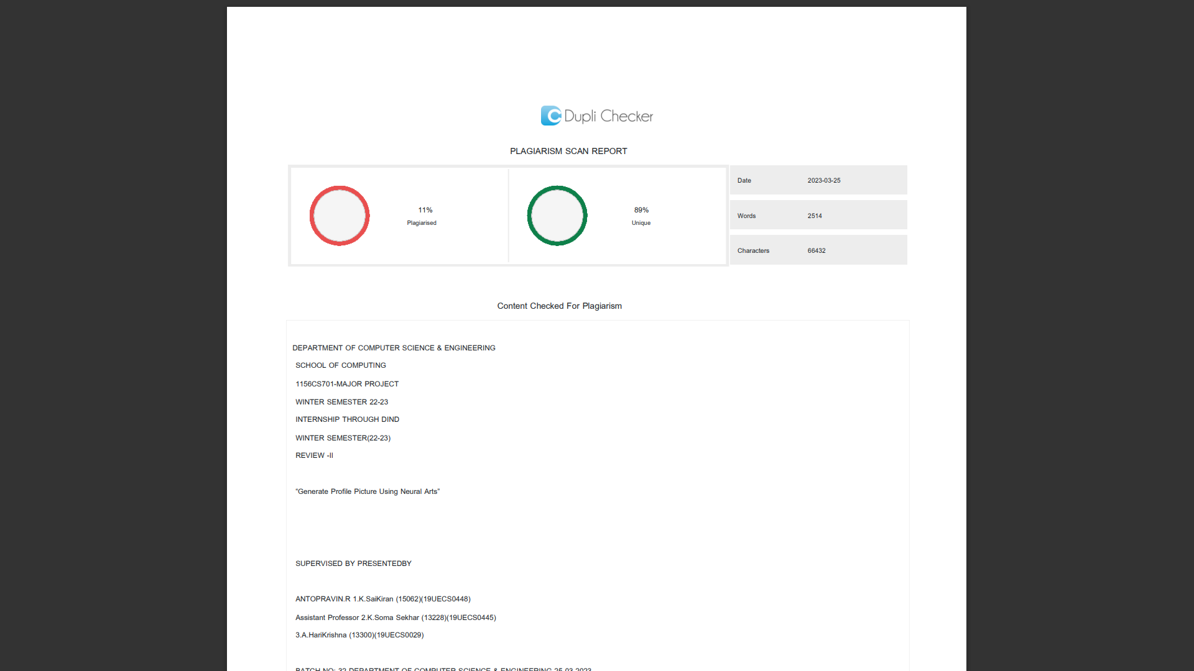
Plagiarism Report of PPT

Slide 35

Internship Certificate

Slide 36
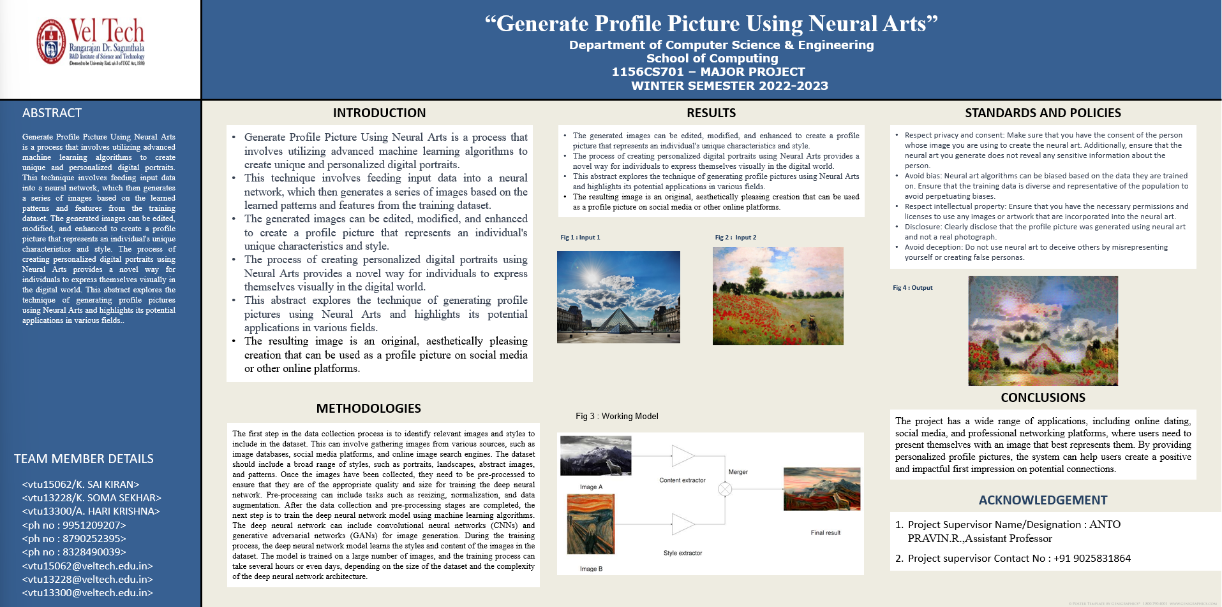
Poster Presentation

Slide 37
THANK YOU

